Slide 1

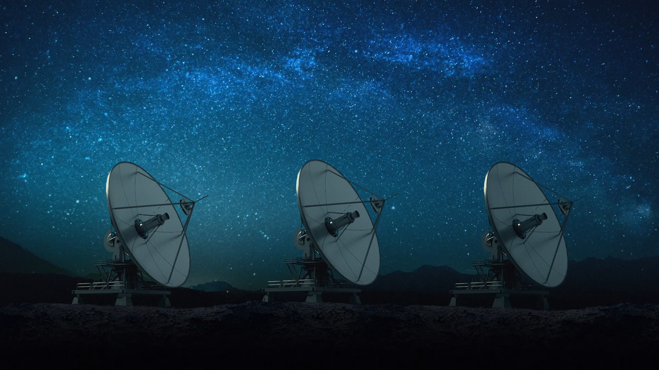
SDR reciever for satellite basics

Slide 2
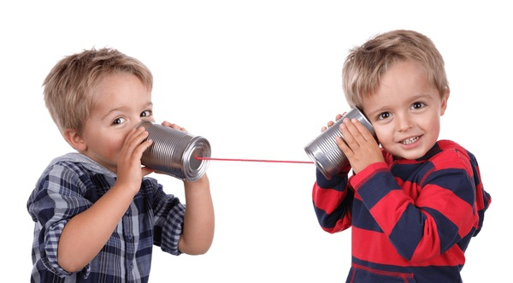
What is a Radio ?
Radio is a device which is capable of sending and receiving signals.
A very simple example is a simple cup and string radio used by kids.
The cup send the vibrations caused by the voice through the string
The string between the cups acts as a channel, a medium to pass the vibrations
The user at the other end receives the voice by listening to the vibrations made by his cup

Slide 3
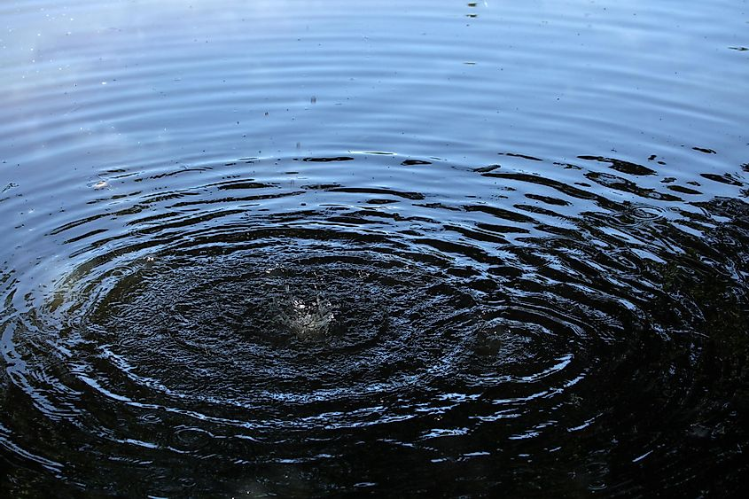
In our project, the channel is wireless. Hence we will be using an antenna to receive signals from the satellite.
The antenna is a device capable of sending and receiving electromagnetic waves without the need of a wire.
Take a small stick and use it to touch the surface of a lake.
It will create waves similar to the image in the left.
Congrats, you have used a stick to propagate waves on the water surface !

Slide 4

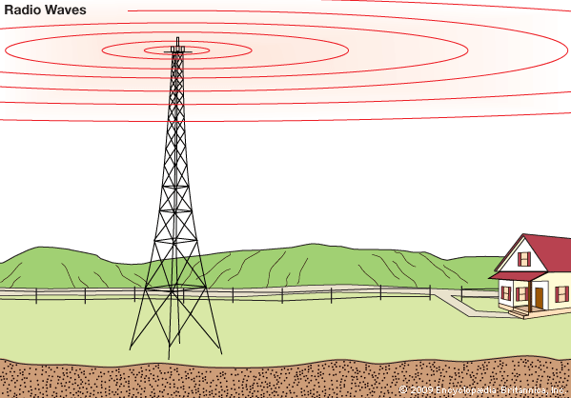



Aren’t they similar ??

Slide 5
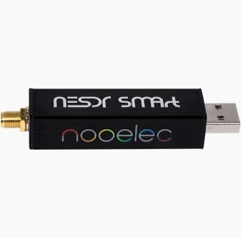
We will be using a dipole rabbit TV antenna for our project as it is a more apt device to communicate with the NOAA series satellites as they perfectly work in the 137-140Mhz frequency range because of their configuration
We need a device to capture and store the signal received by the antenna into our PC devices.
The Nooelectric SDR receiver comes handy in this situation and helps our laptops or PCs to capture the satellite signal.

Slide 6
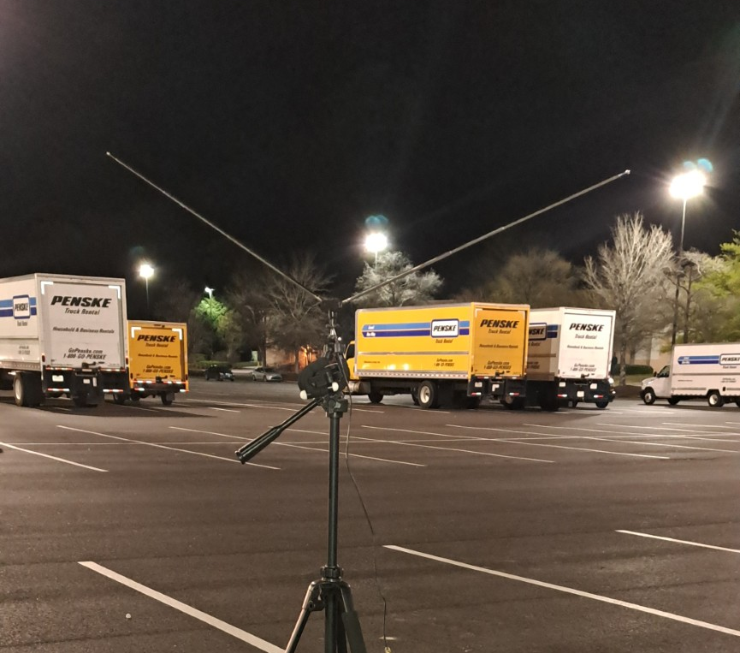
Antenna we used

